Slide 1

Defining Classes
SoftUni Team
Technical Trainers
Software University
https://softuni.bg

Slide 2
Table of Contents
What are Classes?
Class Definition Syntax
Scope and Namespace
The Class Object
2

Slide 3
Have a Question?
sli.do
#python-advanced

Slide 4

What аre Classes?
Building Data Functionality Together

Slide 5
Classes Definition
Classes provide means of building data functionality together
Classes create new types of objects that allow instances of that type to be made
Each class instance can have attributes for maintaining its state
Class instances can also have methods for modifying its state
5

Slide 6
Class Definition Syntax
Class Name
class Person:
def __init__(self, name, age):
self.name = name
self.age = age
Class Method
Instance Attribute
6

Slide 7
Problem: Class Book
Create a class called Book
Upon initialization it should receive a name, author and pages (number)
Submit only the class in the judge system
Use test code to test your code
book = Book("My Book", "Me", 200)
print(book.name)
print(book.author)
print(book.pages)
My Book
Me
200
7

Slide 8

Solution: Class Book
class Book:
def __init__(self, name, author, pages):
self.name = name
self.author = author
self.pages = pages
8

Slide 9

Scope and Namespace
Local, Global and Built-In Namespace

Slide 10
What is Namespace?
A mapping from names to objects
Examples:
Built-in names for example the abs() function
Global names in a module
Local names on a function invocation
There is no relation between names in different namespaces
10

Slide 11
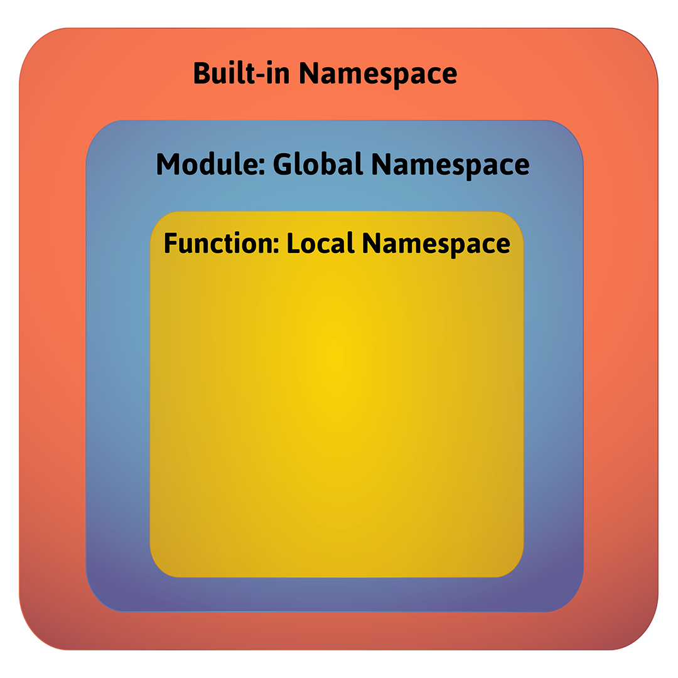
Namespaces Order

Slide 12
What is a Scope?
A region in a program where a namespace is directly accessible
In most of the cases there are at least three nested scopes:
The innermost which is searched first
The scopes of any enclosing functions
The next-to-last scope (module's global names)
The outermost (built-in names)
12

Slide 13
Scopes Example
def scopes():
def local_scope():
text = "local text"
def nonlocal_scope():
nonlocal text
text = "nonlocal text"
def global_scope():
global text
text = "global text"
Local Scope
Nonlocal Scope
Global Scope
13

Slide 14
Problem: Scope Mess
Fix the provided code, so it prints the result expected
Download code from here
# current output
global
outer: local
inner: nonlocal
outer: local
global
# expected output
global
outer: local
inner: nonlocal
outer: nonlocal
global: changed!
14

Slide 15

Solution: Scope Mess
Here are the changes that need to be made
def inner():
nonlocal x
x = "nonlocal"
print("inner:", x)
def change_global():
global x
x = "global: changed!"
15

Slide 16

The Class Object

Slide 17
Class Objects
They support two kinds of operations: attribute references and instantiation
Attribute references
Use standard syntax: obj.name
Valid attribute names are the ones in the class's namespace
Instantiation
Uses function notation
17

Slide 18
Attribute References Example
class MyClass:
"""A simple example class"""
i = 12345
def f(self):
return 'hello world'
MyClass.i and MyClass.f are valid attribute references
Class attributes can also be assigned, so you can change the value of MyClass.i by assignment
18

Slide 19
Instantiation Example
x = MyClass()
Creates a new instance of the class and assigns this object to the local variable x
The instantiation operation creates an empty object
Many classes create objects with instances customized to a specific initial state
Therefore a class may define a special method named __init__()
19

Slide 20
The __init__() Method
class Laptop:
def __init__(self, name, model):
self.name = name
self.model = model
When a class defines an __init__() method, this method is invoked for the newly-created class instance
my_laptop = Laptop("Inspiron 15", "Dell")
20

Slide 21
Problem: Music
Create a class Music that receives title, artist and lyrics upon initialization
It should have 2 methods
get_info() - returns 'This is {title} from {artist}'
play() - returns the lyrics
Submit only the class in the judge system
Test your code with your own examples
21

Slide 22
Solution: Music
class Music:
def __init__(self, title, artist, lyrics):
self.title = title
self.artist = artist
self.lyrics = lyrics
def print_info(self):
return f'This is "{self.title}" from "{self.artist}"'
def play(self):
return self.lyrics
22

Slide 23

Summary
Classes provide means of building data functionality together
A namespace is a mapping from names to objects
A scope is a region in a program where a namespace is directly accessible
Class Objects support two kinds of operations: attribute references and instantiation

Slide 24
Questions?
Notes:
24

Slide 25












SoftUni Diamond Partners

Slide 26




SoftUni Organizational Partners

Slide 27

License
This course (slides, examples, demos, exercises, homework, documents, videos and other assets) is copyrighted content
Unauthorized copy, reproduction or use is illegal
© SoftUni – https://softuni.org
© Software University – https://softuni.bg
Notes:
27

Slide 28
Trainings @ Software University (SoftUni)
Software University – High-Quality Education, Profession and Job for Software Developers
softuni.bg, softuni.org
Software University Foundation
softuni.foundation
Software University @ Facebook
facebook.com/SoftwareUniversity
Software University Forums
forum.softuni.bg
28
Notes:
28

